Slide 1
CORONA VIRUS ANALYSIS USING SQL!
PRESENTED BY DANIYA ANSARI
UNDER THE BATCH MIP-DA-11

Slide 2
01.
INTRODUCTION
The CORONA VIRUS pandemic has had a significant impact on public health and has created an urgent need for
data-driven insights to understand the spread of the virus.
Coronaviruses are a large family of viruses that can cause illness in animals and humans. In humans, they typically cause respiratory infections ranging from mild colds to more severe diseases such as Middle East Respiratory Syndrome (MERS) and Severe Acute Respiratory Syndrome (SARS). The coronavirus disease that emerged in late 2019, known as COVID-19, is caused by the novel coronavirus SARS-CoV-2.

Slide 3
LET’S START: Key Objectives
STEP 1
STEP 2
Data Importing
Data Exploration
STEP 3
STEP 4
STEP 5
SQL Proficiency
Data Analysis
Insights Generation

Slide 4
Dataset: Description of each column in dataset:
Province: Geographic subdivision within a country/region.
Country/Region: Geographic entity where data is recorded.
Latitude: North-south position on Earth's surface.
Longitude: East-west position on Earth's surface.
Date: Recorded date of CORONA VIRUS data.
Confirmed: Number of diagnosed CORONA VIRUS cases.
Deaths: Number of CORONA VIRUS related deaths.
Recovered: Number of recovered CORONA VIRUS cases.

Slide 5
Key Question To Address in The Analysis
Checking for NULL Values
Handling NULL Values
Counting Total Rows
Date Range
Number of Months in Datase.
Monthly Averages
Most Frequent Values
Minimum Values per Year
Maximum Values per Year
Total Cases Each Month
Spread Analysis - Confirmed Cases
Spread Analysis - Death Cases
Spread Analysis - Recovered Cases
Country with Highest Confirmed Cases
Country with Lowest Death Cases
Top 5 Countries by Recovered Cases

Slide 6
Write a code to check NULL values
--Checking NULL values
select * from cvd where recovered is null

Slide 7

Check total number of rows
-- Since in this dataset we dont have any NULL values then we will skip the task of replacing NULL as 0
--Check total number of rows
SELECT COUNT(*) AS total_rows FROM cvd;

Slide 8
Check what is start_date and end_date
SELECT
MIN(Date) AS start_date,
MAX(Date) AS end_date
FROM cvd
;

Slide 9

Number of month present in dataset
SELECT
COUNT(DISTINCT DATEPART(YEAR, Date) * 12 + DATEPART(MONTH, Date)) AS number_of_months
FROM cvd;

Slide 10
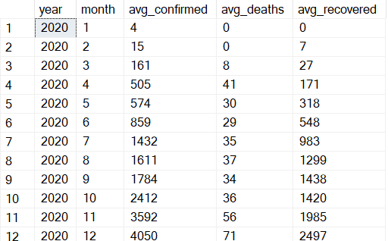
Find monthly average for confirmed, deaths, recovered
SELECT
YEAR(Date) AS year,
MONTH(Date) AS month,
AVG(CAST(Confirmed AS INT)) AS avg_confirmed,
AVG(CAST(Deaths AS INT)) AS avg_deaths,
AVG(CAST(Recovered AS INT)) AS avg_recovered
FROM cvd
GROUP BY YEAR(Date), MONTH(Date)
ORDER BY year, month;

Slide 11
Find most frequent value for confirmed, deaths, recovered each month
WITH monthly_data AS (
SELECT
MONTH(Date) AS month,
Confirmed,
Deaths,
Recovered,
ROW_NUMBER() OVER (PARTITION BY MONTH(Date), Confirmed ORDER BY COUNT(*) DESC) AS confirmed_rank,
ROW_NUMBER() OVER (PARTITION BY MONTH(Date), Deaths ORDER BY COUNT(*) DESC) AS deaths_rank,
ROW_NUMBER() OVER (PARTITION BY MONTH(Date),

Slide 12
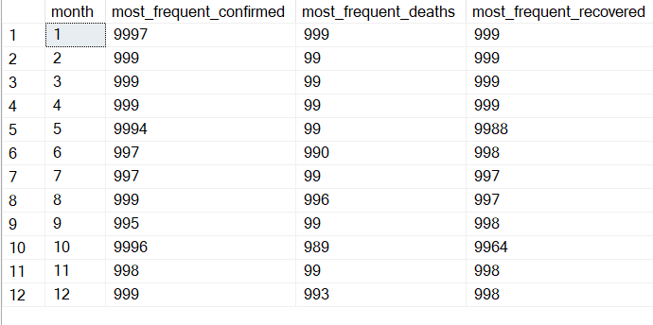
Recovered ORDER BY COUNT(*) DESC) AS recovered_rank
FROM cvd
GROUP BY MONTH(Date), Confirmed, Deaths, Recovered
)
SELECT
month,
MAX(CASE WHEN confirmed_rank = 1 THEN Confirmed END) AS most_frequent_confirmed,
MAX(CASE WHEN deaths_rank = 1 THEN Deaths END) AS most_frequent_deaths,
MAX(CASE WHEN recovered_rank = 1 THEN Recovered END) AS most_frequent_recovered
FROM monthly_data
GROUP BY month

Slide 13

Find minimum values for confirmed, deaths, recovered per year
SELECT
YEAR(Date) AS year,
MIN(Confirmed) AS min_confirmed,
MIN(Deaths) AS min_deaths,
MIN(Recovered) AS min_recovered
FROM cvd
GROUP BY YEAR(Date)
ORDER BY year;

Slide 14

Find maximum values of confirmed, deaths, recovered per year
SELECT
YEAR(Date) AS year,
MAX(Confirmed) AS max_confirmed,
MAX(Deaths) AS max_deaths,
MAX(Recovered) AS max_recovered
FROM cvd
GROUP BY YEAR(Date)
ORDER BY year;

Slide 15
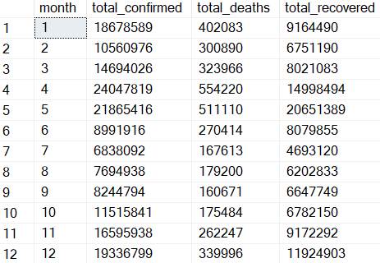
The total number of case of confirmed, deaths, recovered each month
SELECT
MONTH(Date) AS month,
SUM(CAST(Confirmed AS INT)) AS total_confirmed,
SUM(CAST(Deaths AS INT)) AS total_deaths,
SUM(CAST(Recovered AS INT)) AS total_recovered
FROM cvd
GROUP BY MONTH(Date)
ORDER BY month;

Slide 16

Check how corona virus spread out with respect to confirmed case
--With Respect to Total Confirmed Cases
SELECT
SUM(CAST(Confirmed AS INT)) AS total_confirmed_cases
FROM cvd;

Slide 17


--With Respect to Standard Deviation of Confirmed Cases
SELECT
STDEV(CAST(Confirmed AS INT)) AS std_dev_confirmed_cases
FROM cvd;
--With Respect to Average Confirmed Cases
SELECT
AVG(CAST(Confirmed AS INT)) AS average_confirmed_cases
FROM cvd;

Slide 18
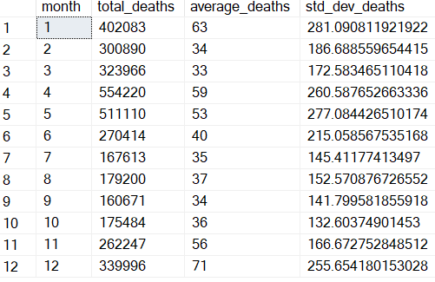
Check how corona virus spread out with respect to death case per month
--With Respect to Total Confirmed Cases, Standard Deviation of Confirmed Cases and Average Confirmed Cases
SELECT
MONTH(Date) AS month,
SUM(CAST(Deaths AS INT)) AS total_deaths,
AVG(CAST(Deaths AS INT)) AS average_deaths,
STDEV(CAST(Deaths AS INT)) AS std_dev_deaths
FROM cvd
GROUP BY MONTH(Date)
ORDER BY month;

Slide 19
Check how corona virus spread out with respect to recovered case
--With Respect to Total Confirmed Cases, Standard Deviation of Confirmed Cases and Average Confirmed Cases
SELECT
SUM(CAST(Recovered AS INT)) AS total_recovered_cases,
AVG(CAST(Recovered AS INT)) AS average_recovered_cases,
STDEV(CAST(Recovered AS INT)) AS std_dev_recovered_cases
FROM cvd
;

Slide 20
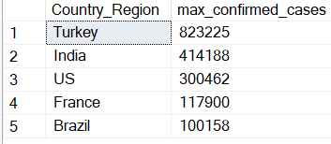
Find Country having highest number of the Confirmed case
SELECT TOP 5
Country_Region,
MAX(CAST(Confirmed AS INT)) AS max_confirmed_cases
FROM cvd
GROUP BY Country_Region
ORDER BY max_confirmed_cases DESC;

Slide 21
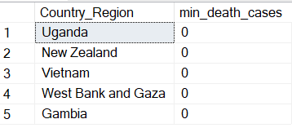
Find Country having lowest number of the death case
SELECT top 5
Country_Region,
MIN(CAST(Deaths AS INT)) AS min_death_cases
FROM cvd
GROUP BY Country_Region
ORDER BY min_death_cases ASC;

Slide 22
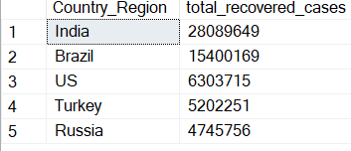
Find top 5 countries having highest recovered case
SELECT Top 5
Country_Region,
SUM(CAST(Recovered AS INT)) AS total_recovered_cases
FROM cvd
GROUP BY Country_Region
ORDER BY total_recovered_cases DESC

Slide 23
Insights / Analytical Results:
Dataset Period: The dataset covers January 22, 2020, to June 13, 2021, totaling 18 months of data on confirmed cases, deaths, and recoveries.
Trends: Average monthly confirmed cases, deaths, and recoveries showed a significant increase, peaking between November 2020 and April 2021, followed by a decline in mid-2021.
Global Totals: Globally, there were 169,065,144 confirmed cases, with maximum in 2020 having 9996 and in 2021 having 9997
Deaths: The dataset recorded a total of 3,522,465 deaths globally.
Recoveries: There were 113,089,548 recoveries globally, highlighting widespread recovery efforts.
Lowest Deaths: Countries like Uganda, New Zealand, Vietnam, West Bank and Gaza and Gambia reported the lowest number of deaths, indicating effective containment or low exposure.
Highest Recoveries: Countries such as India, Brazil, the US, Turkey, and Russia reported the highest number of recoveries, showcasing significant recovery efforts.
This format provides a concise summary of the key points related to COVID-19 statistics during the specified period.

Slide 24
Thank you for your time and interest in our COVID-19 data analysis. If you have any questions or need more information, please don't hesitate to reach out

